Slide 1
Stafford Reece
Aspiring Data Analyst

Slide 2

Overview of Projects
GAmeCo.
Analyzed global video game sales to create a strategy to allocate resources based on its client trends over time.
Hospital Staffing Agency
Evaluated Influenza deaths across the United States of America to better prepare and staff Hospitals to reduce the number of Influenza related deaths.
Rockbuster Stealth LLC
Examined Rockbuster’s top global clients to help launch Rockbusters new online streaming video service.
Instacart basket analysis
Developed a strong understanding of Instacart's clients and basket of goods to help solve business problems and drive revenue.
NYC Yellow
Find options to increase revenue and enhance the value proposition to our cab drivers

Slide 3


Gameco.
Objective:
As such, you’ve been asked to perform a descriptive analysis of a video game data set to foster a better understanding of how GameCo’s new games might fare in the market.
Dataset:
Video Game Dataset from VGChartz's
Skills Used:
Grouping Data
Summarizing Data
Descriptive Analysis
Visualizing Data in Excel
Presenting Data
Cleaning and Formatting Data
Tools Used:

Slide 4
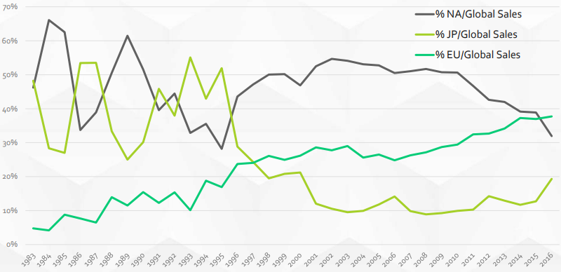
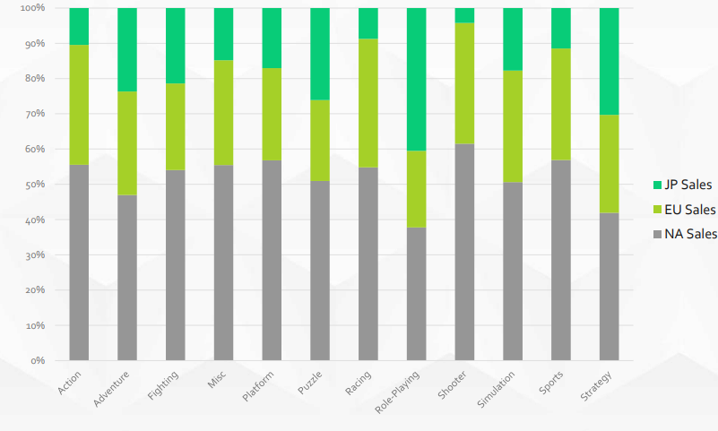
Regional Revenue Compared Against Global Revenue
Regional Video Game Genre Preference’s in relation to Revenue
European market share has been steadily gaining without any major dips or long-term corrections
Japanese market share has declined over the entire period but has steadily gained ground since overall global sales peak in 2008
It appears that the European and Japanese markets are slowly gaining market share of global sales
North America has a strong presence in most categories; but Role-Playing & Strategy are the worst performing genres.
European Sales has a strong presence in Racing & Shooter games – this is especially true when comparing to Japanese Market share
Japanese Sales has a strong presence in Role Playing and Strategy Genre’s with a weak performance in Shooter, Sports, Action and Racing genres

Slide 5
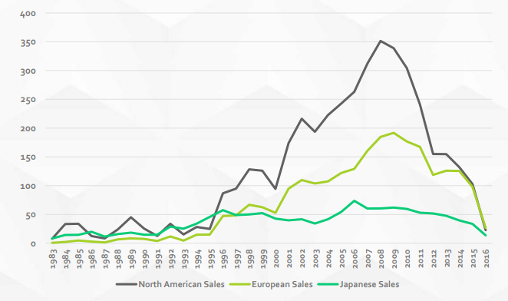
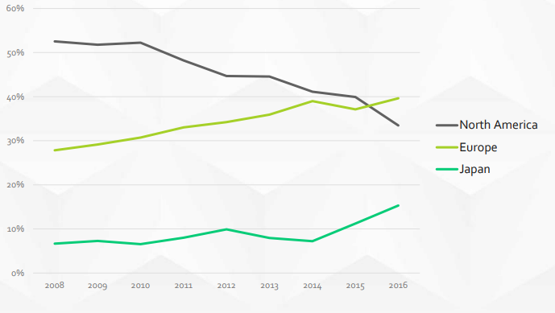
Regional Sales Data
Regional Market Share of Adventure, Action, Platform, Sports, Strategy, Misc, Fighting Genre’s
What we found is that since 2008 Europe has clearly gained a large percentage of market share from North America in North America’s most lucrative genre’s
Japan has gained in sales in these genres as well but not nearly as large of gains, but its clear that Europe and Japan are taking market share from North America.
Based on this information we recommend to allocate less capital towards North America and a higher allocation to Europe for these genres.
We believe a capital allocation change would be most prudent for GameCo’s long term viability given the decline in overall sales.

Slide 6
Recommendations to Gameco.
Allocate capital regionally based on the region’s market share of global sales.
  40% capital allocation to Europe, 35% capital allocation to North America, 15% capital allocation to Japan, the remaining 10% capital allocated to non major regions
  Review the capital allocation yearly and adjust according to the regions market share of global sales.
Each region should then allocate the capital its given based on trends, and allocate more capital to genres growing in market share
  Europe – Increase allocation to Adventure, Action, Platform, Sports, Strategy, Misc, Fighting Genre’s
  Japan – Increase capital allocation to Role Playing and Strategy games – Decrease allocation action, shooter & racing genres
  North America – Understand that market share is declining but still has strong correlation to overall global sales so keep reinvesting in its strongest genres such as Action, Adventure, platform, Sports, Strategy, Mics, Fighting but reduce allocation to Role Playing as Japan is clearly gaining a larger market share year over year.

Slide 7

Hospital Staffing Agency
Objective:
To help a medical staffing agency that provides temporary workers to clinics and hospitals on an as-needed basis. The analysis will help plan for influenza season, a time when additional staff are in high demand. The final results will examine trends in influenza and how they can be used to proactively plan for staffing needs across the country.
Dataset:
Influenza deaths by geography, time, age, and gender
Source: CDC
Download Data Set
2. Population data by geography
Source: US Census Bureau
Download Data Set
Tools Used:
Skills Used:
Translating Business Requirements
Data Cleaning
Data Integration
Statistical Hypothesis Testing
Visual Analysis
Forecasting
Dashboard Design
Video Presentation

Slide 8
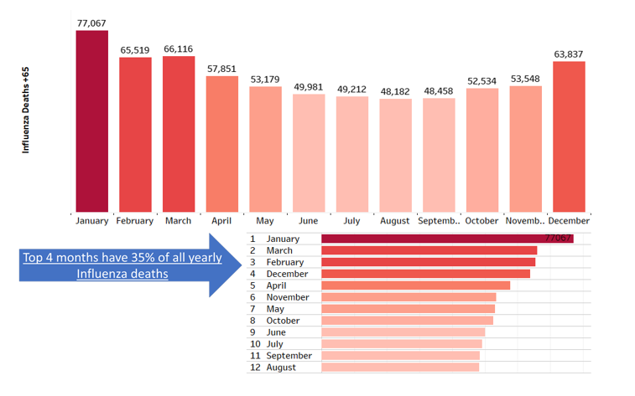
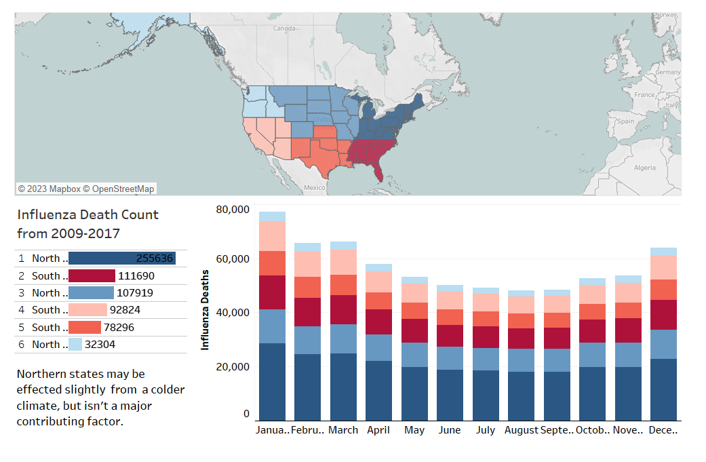
When is the Influenza Season?
Does geography play a role in Influenza deaths?

Slide 9
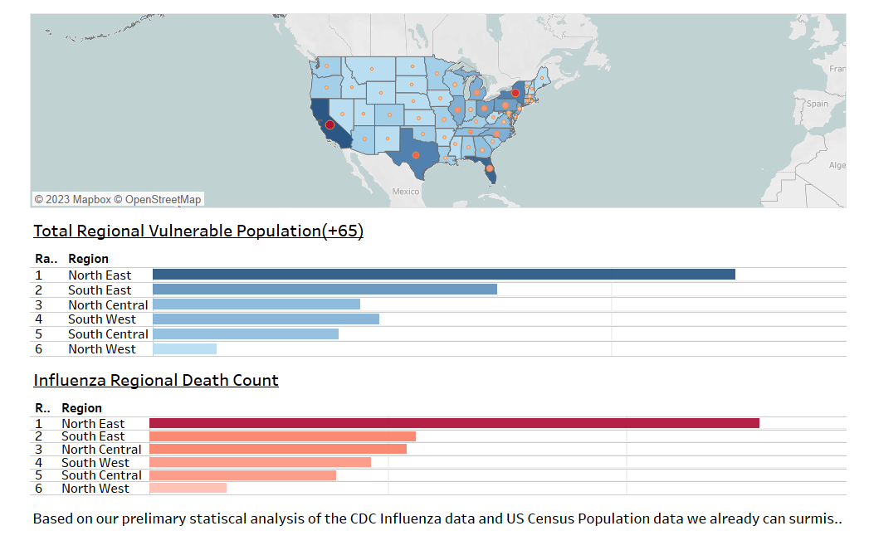
Does density play a role in Influenza death?

Slide 10
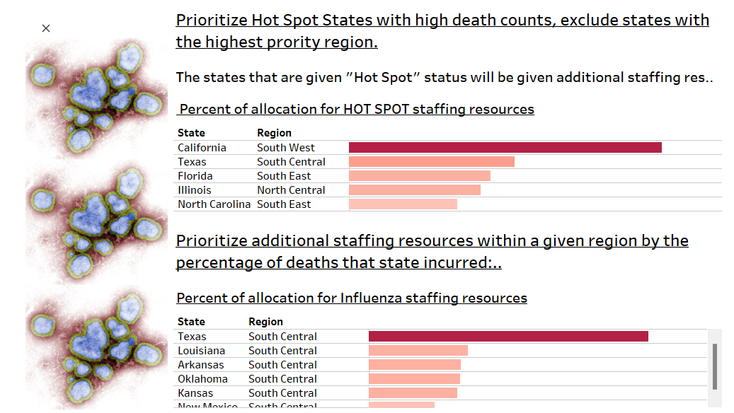
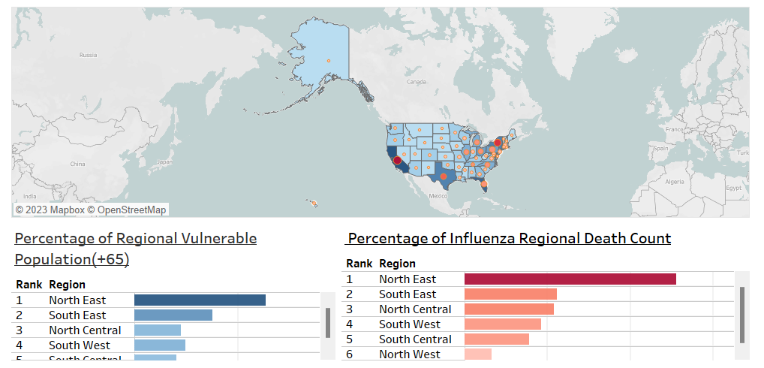
Recommendations:
We should staff hospitals based on the region’s percentage of Influenza deaths.
Prioritize "Hot Spot" states with additional resources or staffing. We will pull those resources from the region with the lowest density of vulnerable population and lowest overall death count. This region is the Northwest Region. We will allocate the 5% of staffing resources for Influenza in the Northwest Region and allocate that to "Hot Spot" states.
Links:
Full Video Presentation:
Hospital Staffing Recommendations for Upcoming Influenza Season – YouTube
Full Story Board on Tableau:
Hospital Staffing Agency Recommendations for Influenza Season | Tableau Public

Slide 11

RockBuster Stealth LLC
Objective:
The Rockbuster Stealth Management Board has asked a series of business questions and they expect data-driven answers that they can use for their 2020 company strategy. Here are the main questions they’d like to answer: Which movies contributed the most/least to revenue gain? What was the average rental duration for all videos? Which countries are Rockbuster customers based in? Where are customers with a high lifetime value based? Do sales figures vary between geographic regions?
Dataset:
Download Rockbuster Data Set
Tools Used:
Skills Used:
Relational Databases
Database Querying
Filtering
Cleaning and Summarizing
Joining Tables
Subqueries
Common Table Expressions

Slide 12
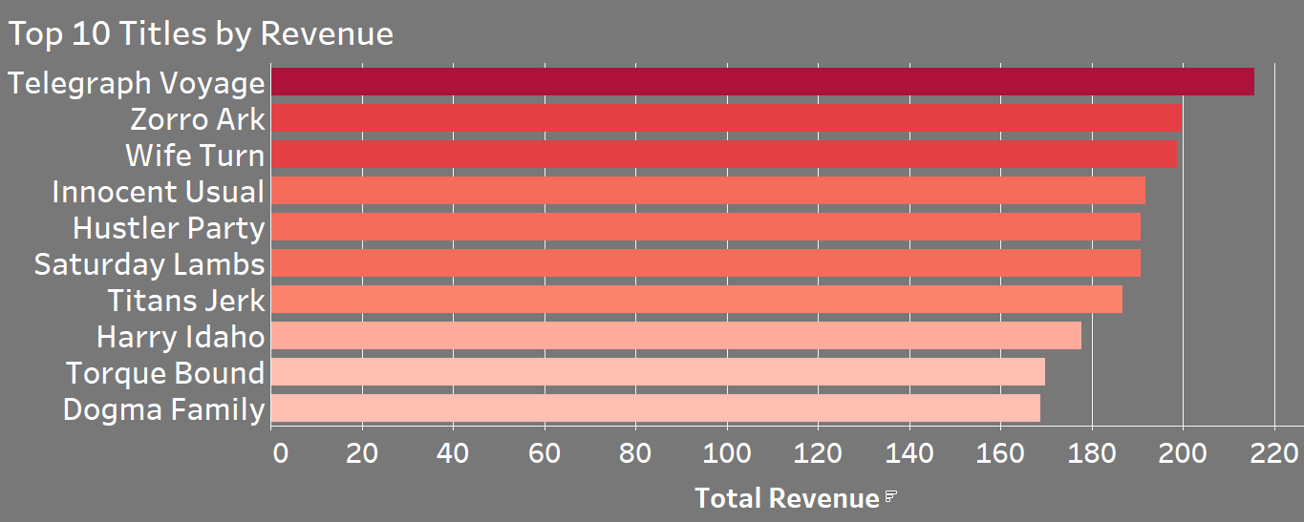
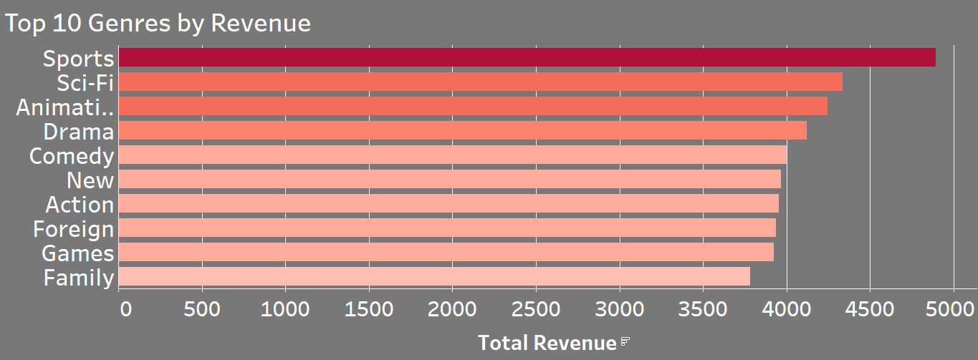
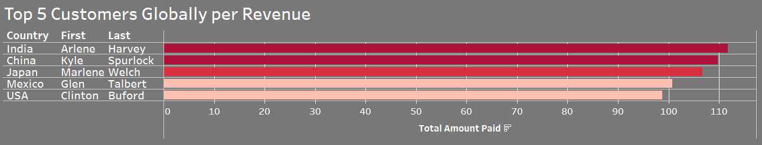
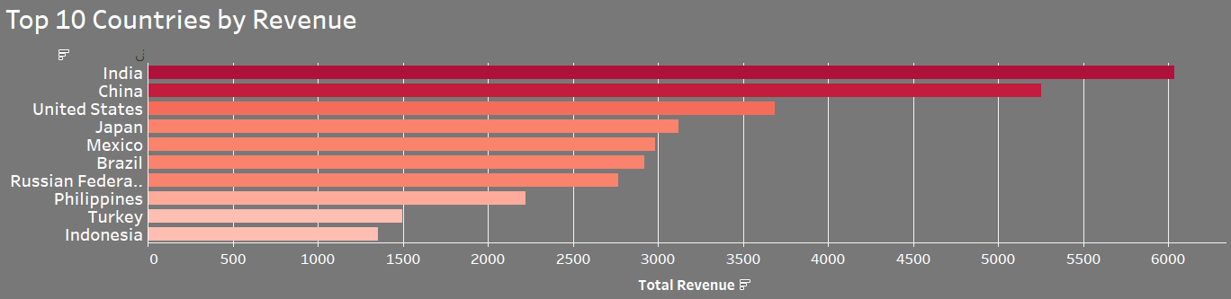
Rockbuster Visualizations

Slide 13
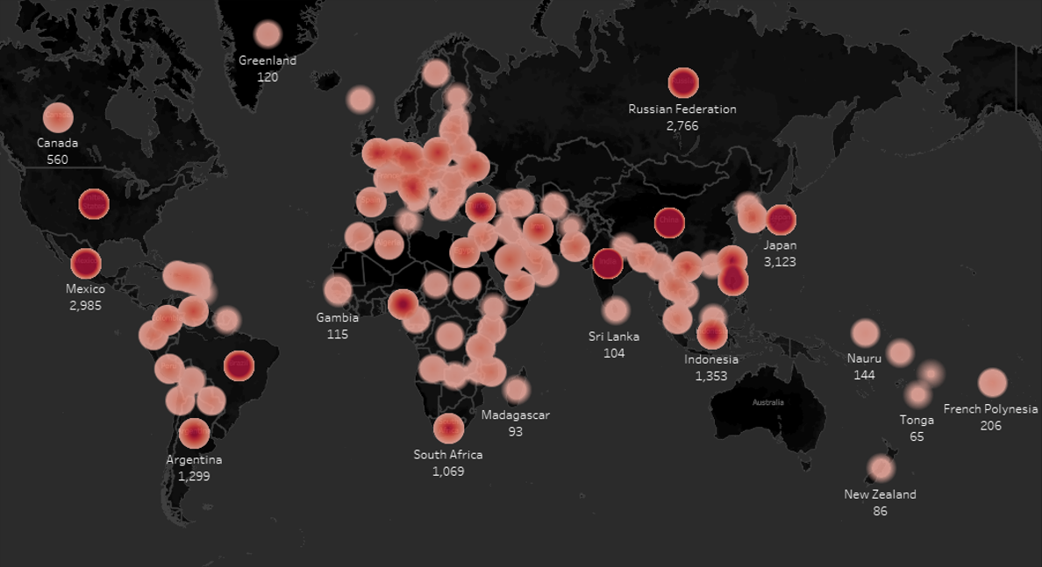
Rockbuster: Total Revenue Per Country

Slide 14
Recommendations for implementing new business segment
Increase spending in largest revenue silos:
PG-13 Rated Movies
Movies within Sports Genre
India, China, & South America
Subscription plan:
Standard plan of $9.99
Premium Plan of $13.99
Create Loyalty Program to retain customers in top markets like:
India, China, USA, Japan, Mexico
Sports is the largest revenue producing genre comprising 8% of total market share in terms of revenue globally. The top ten titles by revenue command 3% of global sales.
Based on this information we believe Rockbuster should update the top ten list of movies daily on the new Rockbuster stealth streaming service to constantly drive demand to the new ecosystem.
Rockbuster should focus a slightly larger number of resources on the Sports genre since it alone compiles 8% of global sales.
Outside of the sports genre the percentage of sales is similar, and resources should be spread evenly so we can reach the largest amount of the addressable market.

Slide 15



InstaCart Basket Analysis
Objective:
You’re an analyst for an existing company, Instacart, an online grocery store that operates through an app. Instacart already has very good sales, but they want to uncover more information about their sales patterns. Your task is to perform an initial data and exploratory analysis of some of their data in order to derive insights and suggest strategies for better segmentation based on the provided criteria.
Dataset:
Download Customer Data Set
Source: www.CareerFoundry.com
Download Instacart Data Set
Source: Kaggle
Tools Used:
Skills Used:
Data Wrangling
Data Merging
Deriving Variables
Grouping Data
Aggregating Data
Reporting
Population Flow

Slide 16
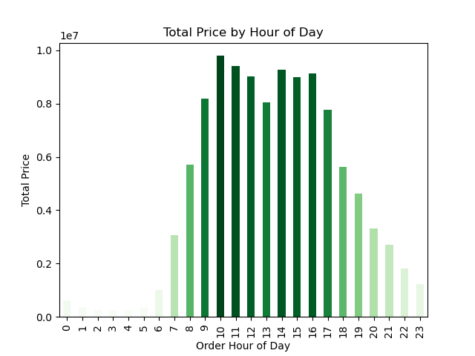
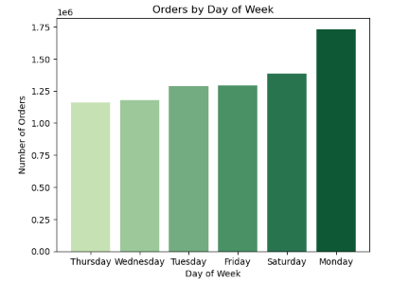
These 2 visuals help to give us a good understanding of the busiest times of the day and the busiest days for Instacart.
Busiest Hours of the Day:
10 AM – 11 AM & 2 PM -3 PM
Busiest Day of the Week:
Monday is by far the busiest day for Instacart.

Slide 17
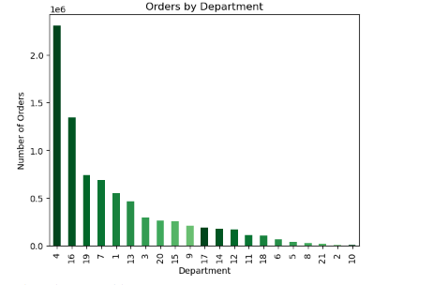
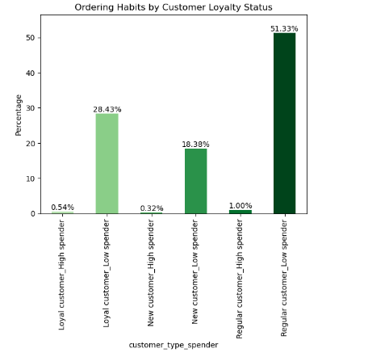
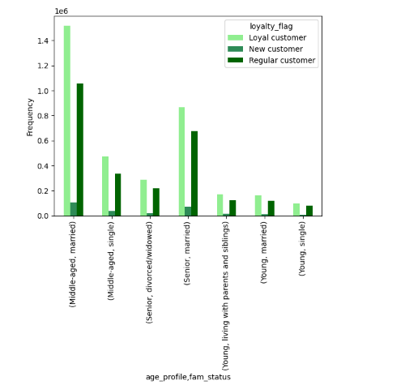
These visuals help us breakdown which departments have the most sales. Produce(4), Dairy/Eggs(16) and Snacks(19).
The next charts break down the ordering habits of the different types of customers that Instacart has Loyal, New and Regular Customer, and if that customer is considered a High or Low Spender with Instacart. From this chart we can see that half or 51% of Instacart's clients are regular customers that spend a low amount. The second highest category is loyal customers that spend low amounts at almost 29% of there customer base.
The 3rd chart to the far right helps to organize customers marital status with how loyal they are to Instacart. Based on this chart the older the client and if they are married the more likely they are to be loyal customers. This makes sense because married couples typically have dual incomes and more need to groceries versus dining out at restaurants, because they have a higher probability of having children.

Slide 18
These visuals help us breakdown which departments have the most sales. Produce(4), Dairy/Eggs(16) and Snacks(19).
The next charts break down the ordering habits of the different types of customers that Instacart has Loyal, New and Regular Customer, and if that customer is considered a High or Low Spender with Instacart. From this chart we can see that half or 51% of Instacart's clients are regular customers that spend a low amount. The second highest category is loyal customers that spend low amounts at almost 29% of there customer base.
The 3rd chart to the far right helps to organize customers marital status with how loyal they are to Instacart. Based on this chart the older the client and if they are married the more likely they are to be loyal customers. This makes sense because married couples typically have dual incomes and more need to groceries versus dining out at restaurants, because they have a higher probability of having children.

Slide 19

NYC Yellow
Objective:
Utilize the companies' data to increase revenue
Dataset:
NYC Yellow Cab Data
Github:
https://github.com/MarkStaffordReece/NYC-Yellow
Link to Tableau Visual
NYC Yellow: Business Report | Tableau Public
Skills Used:
Grouping Data
Summarizing Data
Descriptive Analysis
Visualizing Data in Excel
Cleaning and Formatting Data
Data Wrangling
Data merging, concatenating,
Aggregating Data
Geospatial Data
Translating Business Requirements
Data Cleaning
Data Integration
Statistical Hypothesis Testing
Visual Analysis
Forecasting
Dashboard Design
Utilizing Github for project organization and display
Tools Used:

Slide 20
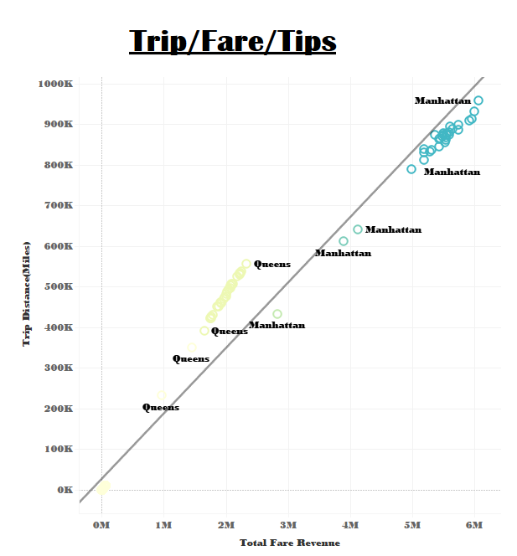
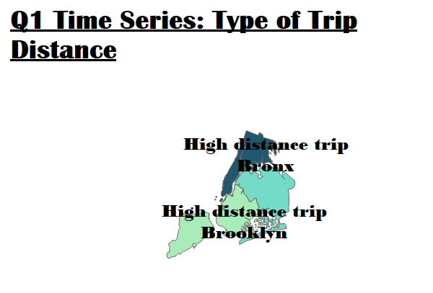
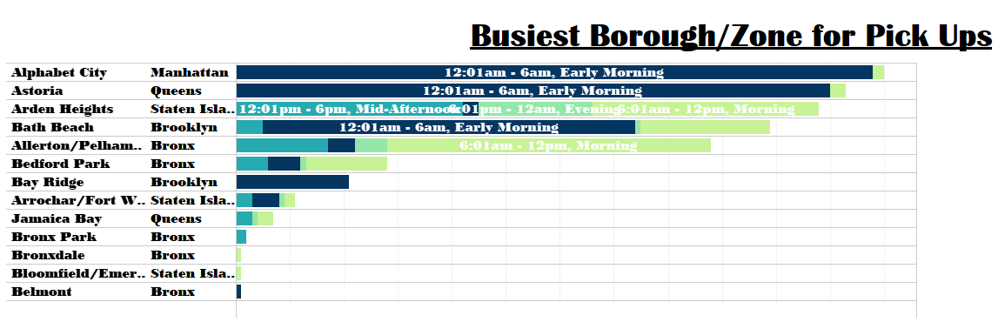
I created scatterplots that helped visualize the relationship between trip distance and fare amount. I created a geospatial map from and then added informative layers to analyze trip distance and fare amount.
This graph helps to show the relationship between borough, zone and time of day. These graphs utilized many different flags that I created with python to help create relationships between the data so its easier to see analyze.

Slide 21
THANK YOU
Stafford Reece
Reecems@vcu.edu

